Slide 1

Biodiversity Challenge – Predicting Frog Presence Using Climate Data
Suman Anand – SXA230187
Sai Kumar – SXK220458
PXT230010
Kaushil Madhubhai Mangaroliya – KMM210014
BUAN 6390.003
Professor Brian Dean

Slide 2

Problem Statement
Predict the presence or absence of frogs across southeastern Australia based on climatic and environmental variables.
Develop a machine learning model using TerraClimate variables to classify frog presence accurately.
F1 Score against provided ground truth labels.

Slide 3
Data Overview
TerraClimate environmental dataset.
Climate variables such as precipitation, evapotranspiration, solar radiation, drought indices, temperature extremes, etc.
Frog presence (1) or absence (0) at given spatial coordinates.

Slide 4
Methodology
Conducted exploratory data analysis and data pre-processing on all 14 bands.
Imputed missing values using Median strategy
Scaled numeric features using Min-Max Scaler
Crated end-to-end preprocessing and modeling pipeline
Structured transformation using ColumnTransforme

Slide 5
Features ?
Selected features from feature importance:
ppt: Precipitation
aet: Actual Evapotranspiration
srad: Solar Radiation
pet: Potential Evapotranspiration
def: Climatic Water Deficit
vap: Vapor Pressure
pdsi: Palmer Drought Severity Index

Slide 6
Model ?
Model: Random Forest Classifier with 5 Folds
Hyperparameters:
n_estimators: 100
Split dataset: 70% training, 30% testing with stratification.
Pipeline trained and validated.
max_depth: 50

Slide 7
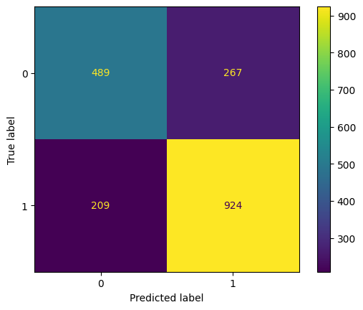
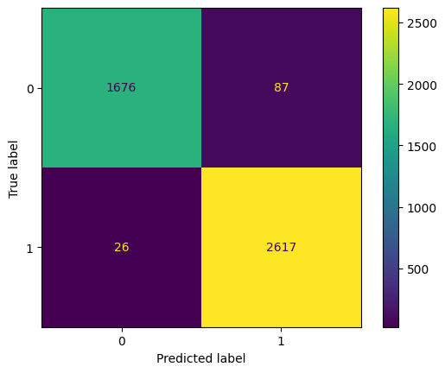

Slide 8
Results !
Final predictions generated on the test set.
Evaluation using the official ground truth file.
Final F1 Score achieved: 82.44%

Slide 9
Value case

Slide 10
Learning

